Slide 1
Enhancing the Public Safety of Tribal Nations through Research & Evaluation Capacity Building:
Recommendations from Tribal Stakeholder Engagement and a Feasibility Study
Eugenia Tyner-Dawson (Sac and Fox) Senior Advisor to the Assistant Attorney General for Tribal Affairs Office of Justice Programs US Department of Justice | Steven Hafner Research Assistant Office of Research & Evaluation National Institute of Justice US Department of Justice
Meghan Doughty Research Assistant Office of Research & Evaluation National Institute of Justice US Department of Justice | Anika Akhter OMH YHEMOP Health Equity Fellow Office of Research & Evaluation National Institute of Justice US Department of Justice
Notes:
Gena, Steven, Meghan, Anika
Welcome & Introductions followed by Gena providing the frame for this presentation and the work we’ve done.

Slide 2
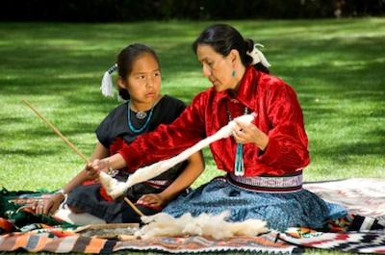
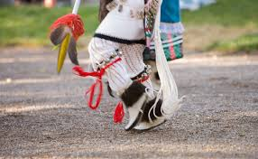
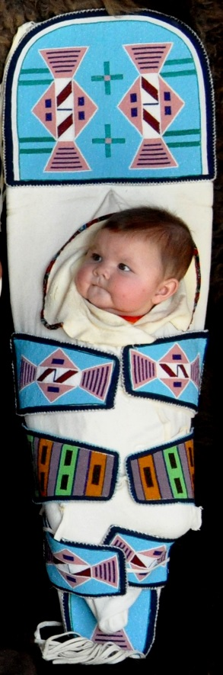
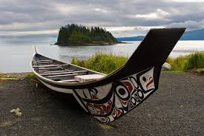
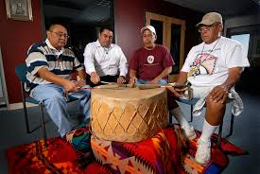
Tribal culture & Traditions
Notes:
Steven
Reference back to Gena’s introduction as a frame for this portion

Slide 3
Agenda
Introductions
NIJ Overview
Areas for Capacity Building
Part I: Beyond “Evidence-based”
Part II: Researcher and Evaluator Development
Current Capacity Building Activities
Feedback and Questions
Notes:
Steven

Slide 4
National Institute of Justice
Office of Justice Programs
U.S. Department of Justice
Research, development, and evaluation agency
Mission: Strengthen Science. Advance Justice
Strategic Goals:
  Foster science-based criminal justice practice
  Translate knowledge to practice
  Advance technology
  Work across disciplines
  Adopt a global perspective
Notes:
Steven
As the research, development and evaluation agency of the DOJ, NIJ is dedicated to improving knowledge and understanding of crime and justice issues through science. NIJ is committed to fostering science-based criminal justice practice, translating knowledge to practice, advancing technology, and working across disciplines.
NIJ is focused on advancing technology for criminal justice application including law enforcement and corrections, forensics, and judicial processes, as well as criminology, criminal justice, and related social and behavioral science research. Much of this research is facilitated by providing grants to academic institutions, non-profit research organizations, and other entities, as well as collaborating with state, local, and tribal governments. Areas of social science research include violence against women, corrections, and crime prevention, as well as program evaluation.
Grants for technology development help facilitate research and development of technology and tools for criminal justice application, which is a need that the private sector is otherwise reluctant to meet. NIJ also supports development of voluntary equipment performance standards, as well as conducting compliance testing.
Areas of technology research and development include biometrics, communications interoperability, information technology, less-lethal technologies (e.g., tasers), and officer safety including bullet-resistant body armor. Crime mapping and analysis is a topic that includes both technology and social science (geography) aspects.

Slide 5
Tribal Research & Evaluation at NIJ
NIJ actively funds research & evaluation (R&E) with tribal communities
Committed to ethical and engaged efforts in line with responsible research conduct and federal trust responsibilities
Notes:
Steven
NIJ has been supporting and directing research and evaluation studies on tribal crime and justice issues since the 1980s. Knowing the long history of unethical and unequitable research practices that so many indigenous populations have been subjected to, NIJ follows a basic premise that all of our tribal studies must establish equitable and mutually beneficial research partnerships. Part of this entails using different strategies at different levels.
NIJ encourages research that will support tribal-nation building and cultural goals and values. Specifically, we encourage studies designed to acquire information and knowledge that will enable tribes to make informed decisions about policies, programs, and community action. Therefore, research teams are expected to demonstrate a commitment to conducting sensitive research in tribal communities using a collaborative and participatory approach that ensures transparency, local buy-in, and coordination.
Researcher teams go into this process with an understanding that developing and implementing the project’s activities collaboratively with federal, state, local, and tribal partners is a necessity. By doing so, results from these studies are expected to help establish and enhance justice systems that successfully restore victim safety and promote healing.

Slide 6
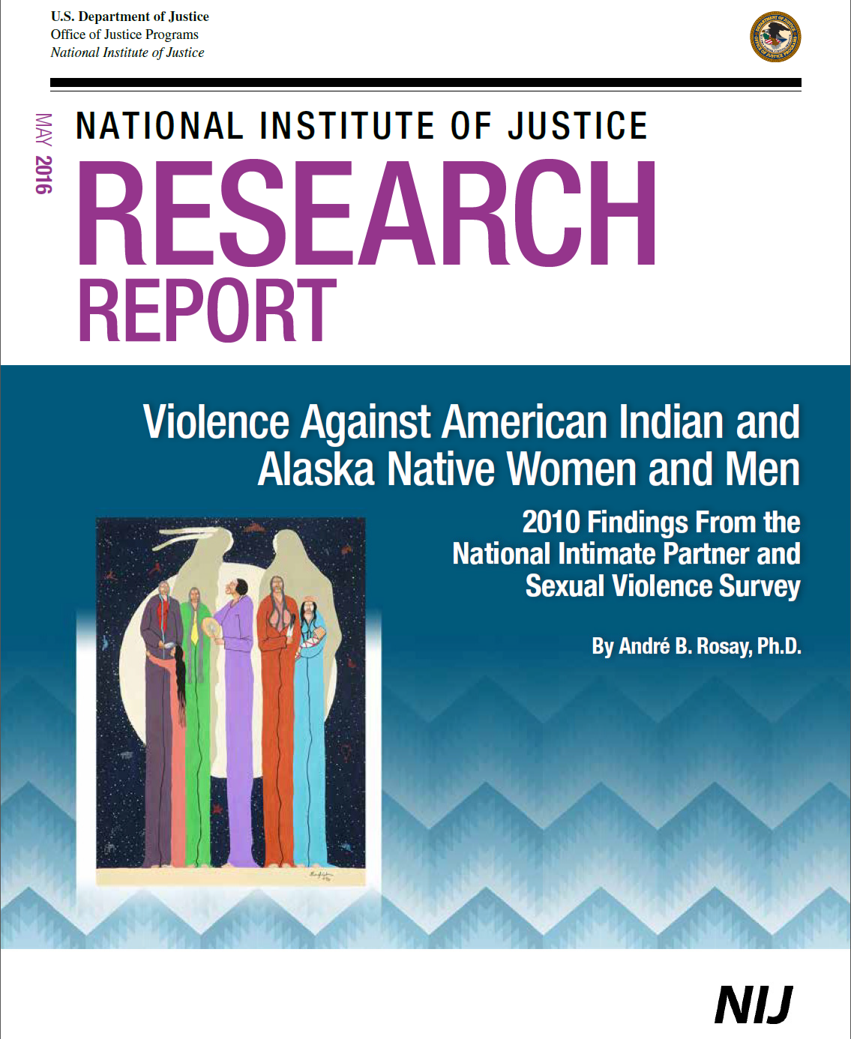
Select NIJ Tribal Studies
Violence Against AI and AN Women and Men Study
Village Public Safety Officer Evaluation
Tribal Youth Victimization Methods Study
Bakken Study – Violence Against Women
Notes:
Steven

Slide 7
What is Capacity Building?
World Health Organization
"...the development and strengthening of human and institutional resources.“
Centers for Disease Control and Prevention
“…generally refers to a process to increase the skills, infrastructure, and resources of individuals, organizations and communities"
Notes:
Steven
We throw around this term in our work, but what do we really mean by it? Most definitions include both an individual and organizational component, which is reflected in the present study by understanding 1. how NIJ can help to enhance individual researcher/evaluator capacity and 2. how NIJ as an organization can be reflexive and enact changes where/when possible to increase R&E on issues of tribal crime and justice.
http://www.who.int/tobacco/control/capacity_building/background/en/
https://www.cdc.gov/hiv/programs/capacitybuilding/index.html

Slide 8
Areas for Capacity Building
Approach
(Institutional)
What are the most appropriate and ethical approaches to R&E with tribal programs and practices?
What counts as “evidence?”
Researchers/Evaluators
(People)
What are the training needs for tribal partners, researchers, and evaluators?
How should this evidence be collected?
What type of infrastructure should be in place to support such partnerships?
How should equitable and mutually beneficial partnerships between tribes and researchers look?
Notes:
Steven
Our R&E capacity challenges are two-fold: approaches to R&E and human resources – we have many related questions…these are just a few. (Further background will be provided before each section)

Slide 9
Part I. Beyond “Evidence-based”

Slide 10
The “Evidence-based” Approach
Evidence-based paradigm
  Need data for funding applications
  Evaluation requirements for funding
Not always appropriate to evaluate cultural practices using standard Western approaches
Notes:
Steven
We live in an “evidence-based world” - doesn’t always work for tribes
Encourage audience to think about the term “evidence-based” within their work.

Slide 11
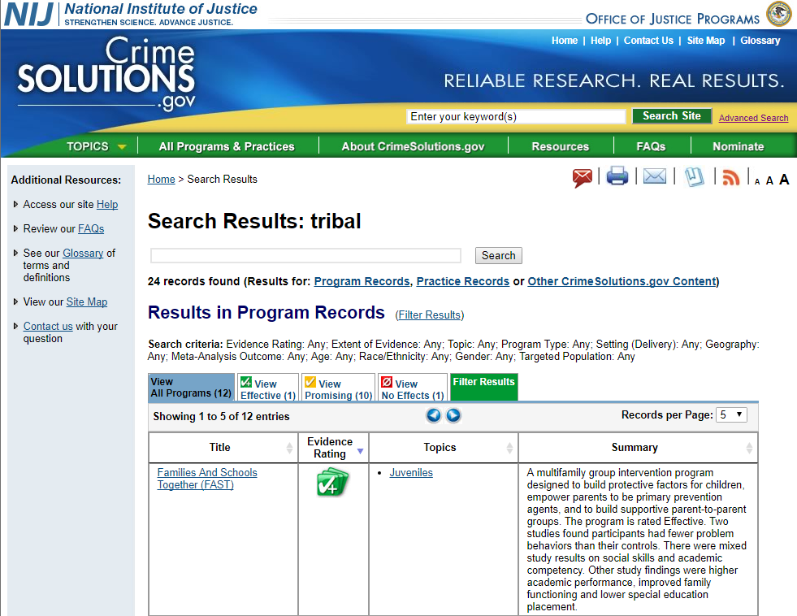
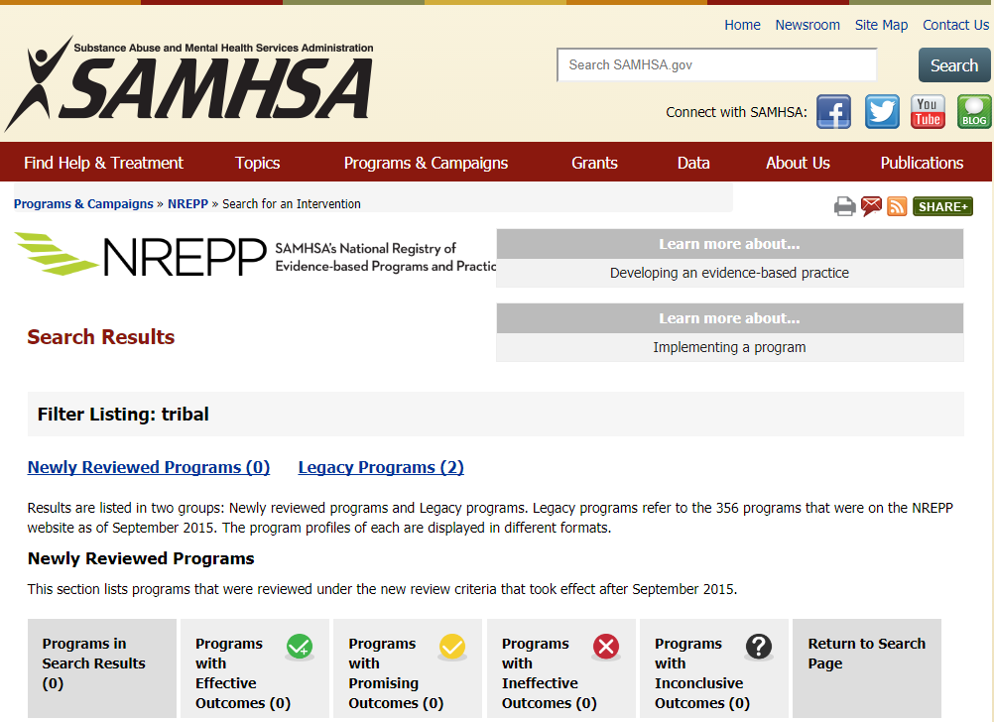
Notes:
Steven
Invite participants to think about times they have been required or recommended to use “evidence-based” practices – did they ever wonder about what that “evidence” was, where and with whom these programs/practices were evaluated, how any adaptation for use in tribal communities might affect fidelity/effectiveness, etc.? So have we!

Slide 12
Tribal engagement
Notes:
Anika
To better understand perspectives from tribal stakeholders and from the field, we engaged in listening sessions.

Slide 13

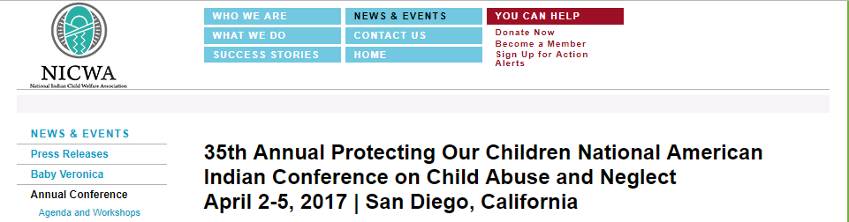
Listening Sessions
Notes:
Anika

Slide 14
Listening Session: Feedback
Challenges and concerns related to evaluation of cultural practices:
  Sacred nature
  Monetization
  Inappropriateness of Western research methods
  Perceived ineffectiveness of cultural practices
Notes:
Anika
Participants brought up various challenges and concerns in evaluating TPPs
For instance, participants expressed a desire to avoid sharing information about the specifics of cultural practices, given their sacred nature
Desire to avoid monetizing cultural practices
Inappropriateness of Western research methods: e.g. RCTs; not ethical or compatible with AI/AN values to withhold cultural practices that may be potentially beneficial
Concerns about non-Natives viewing cultural practices as being ineffective; they may point to dismal stats and argue that our practices are not working, when we know that they are in fact serving the needs of our people

Slide 15
Listening Session: Feedback
Issues with evidence-based practices:
  Overgeneralization of study findings
  Ineffectiveness in tribal communities
  Do not account for traditional/cultural practices
  One-size-fits-all approach
Notes:
Anika
Practice-based evidence: Prevention and treatment approaches that stem from and support the traditional/cultural practices of a particular community
“Our culture is prevention and health promotion”; we know from observation that it works
Overgeneralization of study findings: many EBPs have not been shown to be effective in tribal communities
Additionally, some EBPs are not effective in tribal communities, and this is largely due to cultural irrelevance
Evidence-based programs focus on what works for most people, rather than focusing on the needs of a particular community

Slide 16
Practice-Based Evidence
Evidence-based practice → Practice-based evidence
What is practice-based evidence?
  Example: Oregon Tribal Best Practices
Receptivity by funders: SAMHSA, IHS
Barriers to implementation
  Scientific/research culture
  Lack of funding
Limitation
  Precludes generalization
Notes:
Anika
Definition: A range of treatment approaches and supports that stem from, and are supportive of, the positive cultural of the local society and traditions
Issues related to scientific/research culture: overemphasis on RCTs; value of PBE is not emphasized; limited tolerance for non-RCTs by grant reviewers
Oregon Tribal Best Practices:
1) Transparency: Does the practice have longevity in tribal history? Has it been documented or transmitted through oral history? Can it pass the “Three Grandmothers” test?
2) Standardization: Capable of creating Tribal Based Practice manuals. Practices that are culturally relevant, culturally appropriate, and designed according to the “Indian Way”.
3) Cultural replication: Replication within the tribe and/or other similar tribes. Programs that have been developed and implemented according to the “Indian Way” and have been passed on to others and continue to be implemented and utilized. Our Elders and community members will let us know if we are not doing it right
4) Research: Meets tribal principles. Experts in Native American communities are often elders. They carry the spiritual, cultural and intellectual wisdom of the community. N.A. communities “teachings” provide basis for under-standing what works and why. These teachings are accessed by the Elders and have been the basis for healthy communities for many centuries.
5) Outcomes: Do people show up for one time and then never come again? Or do they come, tell their friends about it, and bring others to participate? Do community members, participants, clients share feedback. This is the “story” of the program. It can be documented. Important to track these measurements, how they change over time.
SAMHSA has encouraged grant applicants who propose a program that has not been formally evaluated to provide other forms of evidence that the practice is appropriate for the population of focus. Evidence for these practices may include unpublished studies, preliminary evaluation results, clinical (or other professional association) guidelines, findings from focus groups held with community members, and other sources.
IHS: The IHS has funded AI/AN communities’ programs through the Methamphetamine and Suicide Prevention Initiative (MSPI). The grant announcement invited communities to develop action plans for “developing or enhancing and implementing community-based, evidence, or practice-based transitional/discharge or aftercare treatment strategies.” Grantees were also required to “include culturally appropriate behavioral, policy, and community approaches to transitional/discharge or aftercare treatment.
Lack of funding for program evaluation

Slide 17
Listening Session: Feedback
Suggestions on how to move towards practice-based evidence:
  Programs → cultural connectedness → positive outcomes (e.g. resilience)
  Statement by tribal leaders
  Tribal determination of success
  Use of qualitative data
Notes:
Anika
There is evidence that cultural connectivity builds resilience and is a good prevention strategy. If we can demonstrate that our programs are increasing those connections, we can demonstrate the effectiveness of cultural practices without drilling down and violating them
Exert tribal sovereignty and get tribal leaders to say that these are our evidence-based practices, which have been systematically tested for centuries; tribal leaders can issue a statement saying these are our EBPs and they work every time
Consult with tribes to determine metrics of success

Slide 18
Research: Literature Review
Notes:
Anika
We wanted to see what the current “state of knowledge” is out there in the published literature about tribal/indigenous culture and outcomes.

Slide 19
Measurement of Ethnic Identity
Data collection methods
  Self-administered questionnaires (n=49)
    Orthogonal Cultural Identification Scale (n=11)
    Multigroup Ethnic Identity Measure (n=7)
    Vancouver Index of Acculturation (n=4)
  Interviews (n=7)
  Talking circles (n=2)
  Focus group (n=2)
  Case study (n=1)
Notes:
Anika
OCIS: Inquires about AI & White American identification. 1) Do you live by the AI/White American way of life? 2) Does your family live by the AI/White American way of life? 3) When you are an adult, will you be a success in the AI/White American way of life? 4) Is your family a success in the AI/White American way of life?
MEIM: Positive ethnic attitudes and ethnic belonging; exploration and resolution of identity issues; ethnic behaviors/practices; e.g. “I have a clear sense of my ethnic background and what it means to me”
Vancouver Index: Measure the degree to which Aboriginal peoples identify with mainstream culture and their heritage culture (e.g. “It is important for me to maintain or develop the practices of my heritage culture”)
Talking circles: 1) Indigenous graduate students and Aboriginal student services coordinators discuss academic success and 2) Aboriginal teachers in Ontario, Canada reflect on language and culture in the classroom
Focus groups: 1) Maori and Pacific university students in New Zealand discuss factors that contribute to their academic success and 2) how Aboriginal adults with diabetes in Winnipeg, Canada cope with stress
Case study of a female adult in a substance abuse treatment center/healing lodge

Slide 20
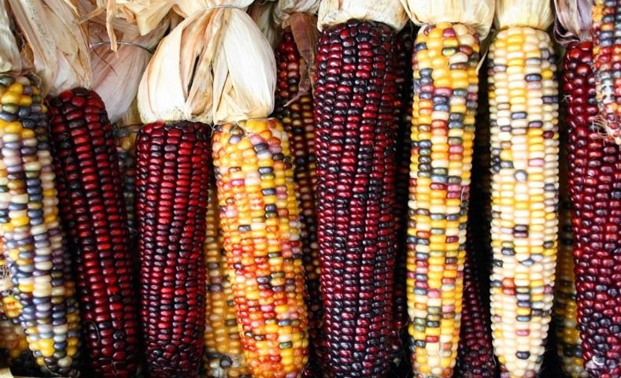
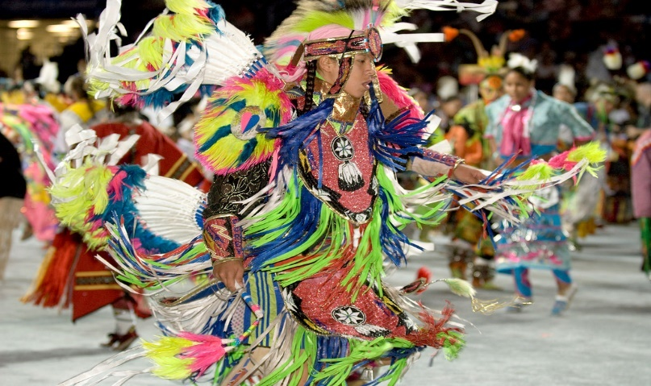
Measurement of Ethnic Identity
Common indicators:
  Participation in traditional activities
  Spirituality
  Native language fluency
Notes:
Anika
Common indicators:
Participation in traditional activities: e.g. consumption of Native foods and medicine, rituals and ceremonies (sweats, pow wows), hunting/fishing/trapping, making traditional arts and crafts
Importance of religion/spirituality for how one lives one’s life, frequency with which one participates in these activities, involvement in traditional spiritual activities (e.g. going to a traditional healer, seeking advice from a spiritual advisor)
Ability to read, write, speak, and understand a traditional language
Other indicators: Respecting elders, time spent on the reservation or frequency of visits to the reservation, ethnicity of friends, having attended or having had a family member who attended residential school, using Indian humor or slang

Slide 21
Outcomes Studied: Quantitative Data Collection (n=49)
Notes:
Anika
This slide highlights the various types of outcomes that have been studied in terms of their connection to American Indian/Alaska Native cultural identification
Limited to the studies that quantitatively examined the relationship between ethnic identity and various outcomes (e.g. used questionnaires)
Note: Some studies measured multiple outcomes
Mental health, substance use, and education were the most common
Mental health: suicide, depression, anxiety, resilience, self-efficacy, hopelessness, helplessness
Substance use: smoking, alcohol, illicit and prescription drugs
Education: academic performance (e.g. grades/GPA); attitudes towards school; academic goals (e.g. plans to graduate high school, attend college)
Health protective behaviors (e.g. physical activity, cervical cancer screening)
Violence/delinquency: physical assault, rape, destruction of property, stealing
Psychosocial functioning/adjustment:
Peer relationships, family relationships, and home duties/self-care; Relation to self and others; daily living skills; impulsive-addictive
Engagement in prosocial behaviors (e.g. helped a friend with homework or a problem, avoided fighting, helped at home)
Health risk/problem behaviors (e.g. poor diet, failure to use seatbelts, gambling, involvement in debt, externalizing behaviors)

Slide 22
Outcomes Studied: Qualitative Data Collection (n=12)
Substance abuse (n=4)
Education (n=4)
Overall health/well-being (n=2)
Mental health (n=2)
Other problem behaviors (n=1)
Health protective behaviors (n=1)
Notes:
Anika
Studies that qualitatively examined the relationship between ethnic identity and outcomes (e.g. interviews, case study, focus group, talking circles)
Note: Some studies were related to various outcomes
Much smaller sample of studies that used a qualitative approach. Substance abuse and education rise to the top again. Many of these studies did not have the relationship between AI/AN cultural identification and an outcome as their primary research question. For instance, some of these studies were talking circles/focus groups with indigenous students doing well in school, and cultural identification emerged as a theme
Problem behavior: staying out of trouble
Health protective behavior: cultural practices as a means of coping with stress

Slide 23
Questions?
Notes:
Brief break for clarifying questions.

Slide 24
Part II. Researcher and Evaluator Capacity
Feasibility of a Tribal Investigator Development Program
Notes:
Steven

Slide 25
Challenges of Building a Tribal R&E Portfolio
Application process
Application requirements
Types of funding mechanisms
Lack of research and evaluation (R&E) capacity
Omitted researcher-practitioner partnership
Cultural competency
Notes:
Steven
Rationale for developing the program:
We haven’t received many solicitations; the ones that we did were low in technical merit; NIJ has had to direct many studies via contracts; focused on consensus documents because peer review is first step of funding decision-making process- provides recommendations to NIJ on policy relevance
From the perspective of a federal science agency
Finding and working with scientists who have a solid understanding of tribal issues (tribal sovereignty, govt-to-govt relationships; criminal and tribal justice systems; jurisdictional complexities; political, economic, and social structures; use of culturally appropriate methods; etc.)
Getting solid, scientific proposals for funding consideration
Recruiting and maintaining a strong pool of scientists to conduct tribal R&E peer review (solicitations and research reports)
Ensuring R&E is collaborative and participatory from birth to grave to ensure transparency and trust

Slide 26
Potential Solution: Investigator Development
For researchers
  Training on principles of ethical and engaged research with tribal communities
For Tribes
  training on the R&E process
  the development and/or implementation of best practices for R&E partnerships
Tribal-researcher partnerships
  tangible and mutually beneficial projects
Notes:
Steven

Slide 27
Tribal engagement
Notes:
Anika

Slide 28
Listening Sessions
Notes:
Anika

Slide 29
Listening Sessions: Feedback
Considerations in developing a capacity building program:
  Tribe-centered
  Cultural congruence
Notes:
Anika
Tribe-centered:
Must obtain buy-in from tribal governments and community members
Partnerships should first and foremost seek to benefit the tribes/address tribal needs and interests
Researchers must seek permission from tribes to access, collect, and share data - how and with whom should data be shared? This speaks to indigenous data sovereignty/ownership.
Priority should be on building indigenous researchers’ capacity, not just anyone who wants to do research in Indian Country
Researchers should be from the same region or have a similar cultural background as the tribes they form a research/evaluation partnership with
Someone who can mentor/train other folks within the community and build community capacity (e.g. Select an elder to work with the research team; tribal point of contact that the government identifies)
Issue with using external researchers: they may not be aware of or understand cultural values

Slide 30
Listening Sessions: Feedback
Potential challenges to establishing such a program:
  Mistrust of external researchers
  Tribal politics
Notes:
Anika
Tribal mistrust due to historical exploitation/abuse of these communities; concerns about data misuse and manipulation
“We have been researched to death”
“Information is used to hurt our people”
E.g. Publishing reports without tribe consensus; not disseminating results to tribes themselves
Tribal politics
Could be related to competition for grant $

Slide 31
Listening Sessions: Feedback
What kind of training to provide to researchers?
  Historical trauma
  Cultural competency
Notes:
Anika
Long-term, intergenerational consequences of historical trauma
How to approach and interact with tribes
Social and cultural norms (e.g., verbal cues and proper body language, what is considered sacred)
Not telling tribal communities how to do things; asking them what they want, what their interests and needs are

Slide 32
Listening Sessions: Feedback
Building capacity of tribal youth
  Scholarships & fellowships
  Career pipeline
  Exposure to traditional criminal justice approaches
Notes:
Anika
Scholarships
Provide scholarships/fellowships to tribal youth to conduct criminal justice and STEM research in their communities
Partner with local sites so that youth aren’t away from the community (e.g., in DC) the entire time
Career pipeline
Programs that encourage youth to pursue social/behavioral sciences
Start early- 5th/6th grade
Would entail establishing partnerships with school districts and chiefs of county, obtaining buy-in from parents
Recognizing that there is more to criminal justice than merely cops and policing
e.g., Traditional approaches to maintain order and achieve justice in tribal communities that do not have police agencies

Slide 33
Feasibility study
Notes:
Meghan

Slide 34
Research Questions
What have been the major strengths and weaknesses of previous research grant applications involving tribal communities and programs?
What do potential and former applicants think about NIJ funding opportunities?
How have other federal agencies approached development of R&E capacity building programs?
Notes:
Administrative review
Eligible applicant survey
Federal personnel interviews

Slide 35
methods
Notes:
Meghan

Slide 36

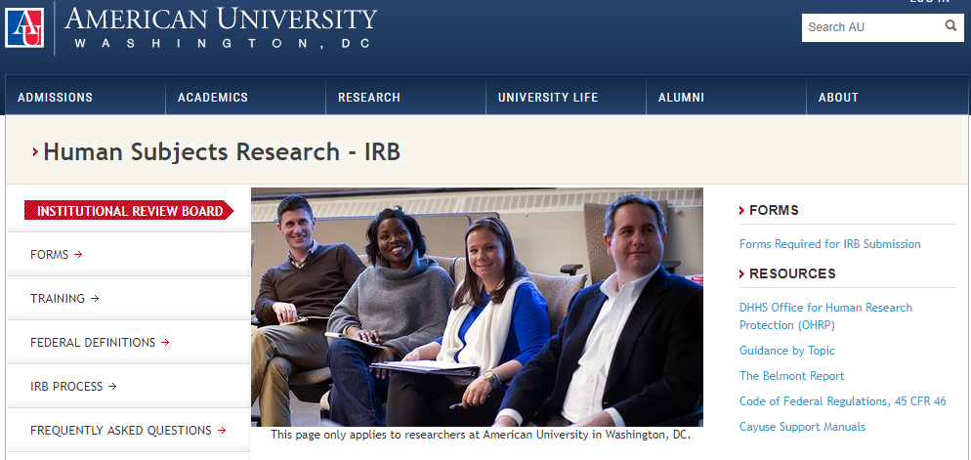
Approvals
Institutional Review Board Exemptions
  American University
  Harvard University
Required Privacy Certificates filed with USDOJ
Notes:
Meghan
All research activities had appropriate approvals – research staff only included Steven and Meghan

Slide 37
Administrative Review
Aim
To determine strengths and weaknesses of previously submitted research grant applications involving tribal communities and programs
Sample
Scientific external peer review documents
Method
Iterative thematic content analysis
Notes:
Meghan
NIJ has a three tiered peer review process: (1) external peer review consisting of scientists and practitioners/policymakers; internal scientific staff review; director's decision. The NIJ Director is the only one who makes funding decisions. What was reviewed in this analysis, were the external peer review documents, recommendations written by outside scientists and practitioners. This was an iterative thematic content analysis of one-tier of the NIJ peer review process

Slide 38
Eligible Applicant Survey
Aim
To understand what potential and former applicants think about NIJ funding opportunities
Sample
Individuals eligible to apply for NIJ grants
Method
Electronic survey
Notes:
Meghan
Researchers and evaluators who presented within last 3 years at American Public Health Association, American Society of Criminology, or American Evaluation Association on a topic related to tribal, American Indian, Alaska Native, Native American, or indigenous issues.
Why these particular conferences? Largest pool of researchers relevant to our research question. Open access databases. Mix of researchers and practitioners.

Slide 39
Federal Personnel Interviews
Aim
To understand capacity building program development efforts of other federal agencies
Sample
Federal program officers managing grants/programs aimed at capacity building posted in the last 5 years
Method
Telephone interview
Notes:
Meghan
Focused on grants solicitations within the previous 5 years that focused on 1. building the diversity of investigators, or 2. focused on building a diverse research portfolio through grants targeted at diverse populations.
Searched Grants.gov for all open, closed, and archived grants from past 5 years using:
(research* or evaluat*) AND (train* or capacit* or develop* or enhance* or career*)
Then searched spreadsheet for "diversit," "minorit," "underrepresent," "indian," or "native," "trib" - must be in title to show program is specifically about these groups
Exported all grants to Excel
Completed abstract read-through to ensure meet eligibility criteria
Original search: 3,054
Relevant titles: 104
Eligible solicitations: 52
With contact information for interview outreach: 42

Slide 40
results
Notes:
Meghan
Can only discuss results for admin review and eligible applicant survey, as the federal personnel interviews are still ongoing

Slide 41
Results: Administrative Review
Experience working with AI and AN communities
    Strength
      Knowledge of the tribal IRB process
      “The applicant recognizes the importance of seeking tribal approval prior to dissemination of study results”
    Weakness
      “the proposal…, violates basic principles of research in American Indian Alaska Native communities. As a result, the proposal displays no cultural competency and appears to provide… ethnocentric exploitation”
Notes:
Meghan
Remember when looking at these quotes that they are only one-tier of the NIJ peer review process and that the NIJ Director is the only one who makes funding decisions. These are common themes that arose in the comments made by external practitioners and scientists.
Define IRB: Institutional Review Board; protects human subjects and ensures confidentiality of data
Relationships with AI/AN organizations, partnerships, MOU’s, letters of support, input on the products
Seeking tribal approval via tribal resolution, executive order, or participatory agreement

Slide 42
Results: Administrative Review
Dissemination Strategy
  Strength
    “The proposal contains several innovative ways of disseminating the findings of the research, including oral transmission at Pow Wows and other community events, reports to the Bureau of Indian Affairs or Indian Health Services, and a Tribal community public forum.”
  Weakness
    “…the dissemination plan does not include major collaboration with tribal leaders, and only plans to distribute information to tribes through conference presentations. It is a significant weakness that more effort has not been exerted to collaborate with tribal leaders and to at least reach out to tribal communities and service providers to share information about the findings”
Notes:
Meghan
Strength dissemination strategies that focus on getting information to tribal stakeholders and avoid helicopter research

Slide 43
Results: Administrative Review
Narrative (Scope of Work)
  Weaknesses
    “Although the narrative offered many general statements about the value of this work, it failed to identify specifically what its contribution would be above and beyond what is currently in the literature”
    “…methods and analytic and technical approach requires many more specifics”
    “The justification for the ‘other’ costs, which are not small, could use more detail as to why they are necessary”
Notes:
Meghan
Detail – inclusion, exclusion criteria for survey and research design, budget narratives, disseminations plans, biggest complaint overall by outside peer reviewers was the need for more detail on every aspect of the proposals

Slide 44
Results: Administrative Review
Personnel Costs
  Weaknesses
    “there is nothing in the way of a plan to train and support (much less pay) the tribal representatives who would be responsible for administering the paper-and-pencil pilot test…”
    “Personnel budget is very high, particularly for the three principal personnel…”
  Strength
    “the extra costs associated with the focus group consultant and the extensive need for travel is well justified.”
Notes:
Meghan
Failing to compensate tribal “partners” for their time, money, and involvement
Mismatch between program narrative and budget narrative

Slide 45
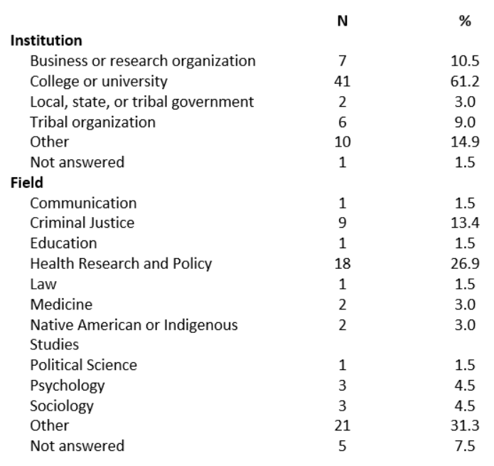
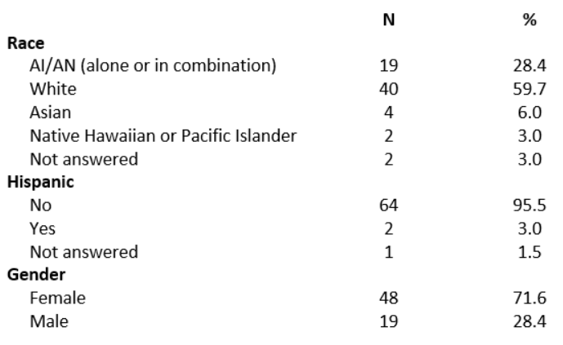
Results: Eligible Applicant Survey -
Demographics (n=67)
Notes:
Meghan

Slide 46
Results: Eligible Applicant Survey –
Resources (n=53)
“It requires a truly mutually beneficial partnership that goes beyond a transactional, information-based relationship to one that is more human and values-based. Info & resources aren't enough“
“Comprehensive information about tribal data sovereignty and considerations in doing research with Urban Native populations”
“Appropriate tribal consultation strategies, community based participatory research principles “
37.7%
Do not know where to get the resources they need
Notes:
Meghan
Question: What information and resources do you believe would be helpful in facilitating a research partnership with tribal communities and nations?
Variety of Responses- these are representative quotes
A number of respondents stated this was too complex a question for the survey and I think the first quote really gets at what those people were expressing - that a list of do’s and don’t in tribal research is not sufficient, however we can always improve and the other two quotes represented concrete steps/information that the research community believes are important and need to be flagged when doing tribal research

Slide 47
Results: Eligible Applicant Survey –
NIJ Knowledge (n=61)
Before this survey, did you have knowledge of NIJ?
Notes:
Meghan

Slide 48
Results: Eligible Applicant Survey –
NIJ Applicant (n=36)
Have you ever been part of an NIJ tribal grant application?
Notes:
Meghan

Slide 49
Results: Eligible Applicant Survey –
Engagement (n=48)
What could NIJ do to engage you in future funding?
Notes:
Meghan
Responses fell into four main thematic groupings: advertising, - most had not heard of NIJ funding opportunities and encouraged NIJ to “Routinely disseminate funding opportunity announcements “
engaging with tribal colleges and communities – tribal colleges
providing more external grant application assistance – webinars to provide funding information, clearer criteria of what makes a successful grant application
grant structure – Funds to support a planning process that would help determine what NIJ research topics are of interest/importance to our tribes, so we can identify surveillance/research partners who might be relevant partners to carryout the research, changing the funding mechanism from a cooperative agreement to a grant

Slide 50
Limitations & Further work
Notes:
Meghan

Slide 51
Limitations
Listening Sessions: limited in number
Literature Review: search terms, databases
Admin Review: only reviewed first tier of grant application review process
Applicant Survey: only 3 conferences (none tribal)
Notes:
Meghan
No study is perfect. These are but a few limitations of our study.

Slide 52
Future Work
Complete reports and conduct presentations to NIJ leadership
Further stakeholder guidance and feedback on responses to recommendations
Notes:
Steven

Slide 53
Current Capacity Building Activities
Student engagement
  Society for Advancement of Chicanos/Hispanics and Native Americans (SACNAS)
  American Indian Science and Engineering Society (AISES)
International Association of Chiefs of Police Annual Conference Travel Scholarships
Cross-office collaborations
  National Missing and Unidentified Persons System
  Video training series
Cross-agency collaboration
  HHS’s Office of Minority Health - Youth Health Equity Model of Practice (YHEMOP) Fellow
Notes:
Steven
Our efforts are actually active and continuing – trying a broad array of engagement and collaboration to improve our work with tribal nations.

Slide 54
Acknowledgments
Christine Crossland, Sr. Social Science Analyst, NIJ
James Fort and Scott Herzberg, Office of Justice Programs Librarians
HHS, Office of Minority Health
Notes:
Steven

Slide 55
Disclaimer
The data analysis in this presentation was supported by Award Nos. 2014-IJ-CX-K005 and 2015-IJ-CX-0014, awarded by the National Institute of Justice, Office of Justice Programs, U.S. Department of Justice.
The opinions, findings, and conclusions or recommendations expressed in this presentation are those of the author and do not necessarily reflect those of the Department of Justice.

Slide 56
Feedback & Questions
Notes:
Steven

Slide 57
Contact
Additional Comments:
TribalResearch@usdoj.gov
Questions or Concerns:
Steven Hafner
Steven.hafner@usdoj.gov
Notes:
Steven

